Slide 1
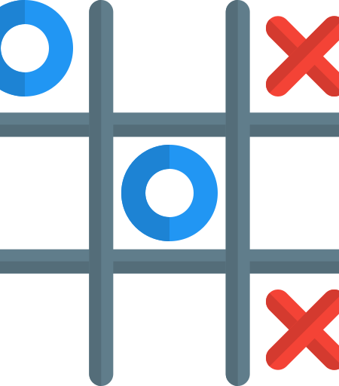

Simplbyte Internship
Name- UMME KULSUM
JAVA INTERN
Batch- April
Task #01- Tic Tac Toe Game

Slide 2
Task #01 TIC TAC TOE GAME
Create a 2D array to represent the game board. This array will hold the X's and O's that are placed by the players.
Create a method to print the game board. This method will iterate through the 2D array and print out the X's, O's, and blank spaces.
Create a method to handle player moves. This method will prompt the player to enter their move (row and column) and then update the game board with their choice.
Create a method to check for a winner. This method will check the 2D array for three in a row of X's or O's. If a winner is found, the game will end and the winner will be declared.
Create a main method to run the game. This method will initialize the game board, loop through player turns, and call the other methods to update the game board, check for a winner, and print the game board. The game will continue until a winner is found or the game ends in a tie.

